Slide 1


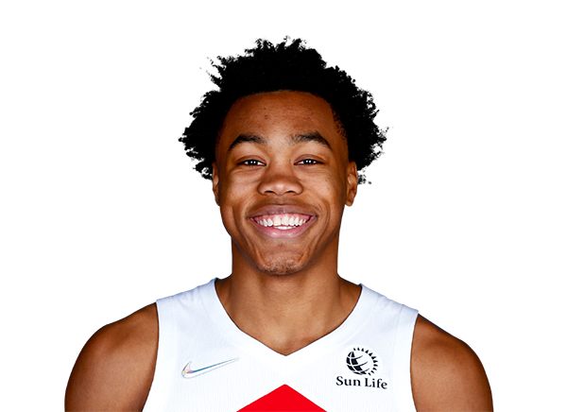




THROUGH OCTOBER 23
 | Player | Team | GP | AST | REB | PTS | ROY Score
 | Evan Mobley | CLE | 3 | 3.0 | 8.3 | 15.7 | 438.00
 | Scottie Barnes | TOR | 3 | 1.7 | 10.0 | 18.0 | 326.37
 | Chris Duarte | IND | 3 | 2.3 | 4.7 | 20.3 | 199.32
 | Franz Wagner | ORL | 2 | 1.0 | 4.0 | 14.0 | 152.25
 | Josh Giddey | OKC | 2 | 3.5 | 6.0 | 5.0 | 65.00
NBA STAT PADDER

Slide 2
THROUGH OCTOBER 23
 | Player | Team | GP | AST | REB | PTS | ROY Score | Rank Change
 | Evan Mobley | CLE | 3 | 3.0 | 8.3 | 15.7 | 438.00 | 0
 | Scottie Barnes | TOR | 3 | 1.7 | 10.0 | 18.0 | 326.37 | 0
 | Chris Duarte | IND | 3 | 2.3 | 4.7 | 20.3 | 199.32 | 0
 | Franz Wagner | ORL | 2 | 1.0 | 4.0 | 14.0 | 152.25 | 0
 | Josh Giddey | OKC | 2 | 3.5 | 6.0 | 5.0 | 65.00 | 0
NBA STAT PADDER

Slide 3


THROUGH OCTOBER 31
 | Player | Team | GP | AST | REB | PTS | ROY Score
 | Scottie Barnes | TOR | 7 | 2.0 | 8.9 | 18.1 | 332.82
 | Evan Mobley | CLE | 7 | 2.6 | 7.6 | 13.4 | 290.05
 | Josh Giddey | OKC | 6 | 5.7 | 5.8 | 10.7 | 173.88
 | Franz Wagner | ORL | 7 | 1.9 | 3.6 | 13.9 | 138.42
 | Chris Duarte | IND | 7 | 2.4 | 4.7 | 17.7 | 136.94
NBA STAT PADDER

Slide 4
THROUGH OCTOBER 31
 | Player | Team | GP | AST | REB | PTS | ROY Score | Rank Change
 | Scottie Barnes | TOR | 7 | 2.0 | 8.9 | 18.1 | 332.82 | ↑1
 | Evan Mobley | CLE | 7 | 2.6 | 7.6 | 13.4 | 290.05 | ↓1
 | Josh Giddey | OKC | 6 | 5.7 | 5.8 | 10.7 | 173.88 | ↑2
 | Franz Wagner | ORL | 7 | 1.9 | 3.6 | 13.9 | 138.42 | 0
 | Chris Duarte | IND | 7 | 2.4 | 4.7 | 17.7 | 136.94 | ↓2
NBA STAT PADDER

Slide 5
THROUGH NOVEMBER 8
 | Player | Team | GP | AST | REB | PTS | ROY Score
 | Scottie Barnes | TOR | 9 | 2.4 | 8.7 | 16.6 | 309.85
 | Evan Mobley | CLE | 11 | 2.5 | 8.0 | 14.9 | 303.50
 | Josh Giddey | OKC | 9 | 5.9 | 6.1 | 10.1 | 149.14
 | Chris Duarte | IND | 11 | 2.4 | 4.5 | 16.0 | 145.6.
 | Franz Wagner | ORL | 11 | 2.1 | 3.5 | 9.1 | 132.71
NBA STAT PADDER

Slide 6
THROUGH NOVEMBER 8
 | Player | Team | GP | AST | REB | PTS | ROY Score | Rank Change
 | Scottie Barnes | TOR | 9 | 2.4 | 8.7 | 16.6 | 309.85 | 0
 | Evan Mobley | CLE | 11 | 2.5 | 8.0 | 14.9 | 303.50 | 0
 | Josh Giddey | OKC | 9 | 5.9 | 6.1 | 10.1 | 149.14 | 0
 | Chris Duarte | IND | 11 | 2.4 | 4.5 | 16.0 | 145.6. | ↑1
 | Franz Wagner | ORL | 11 | 2.1 | 3.5 | 9.1 | 132.71 | ↓1
NBA STAT PADDER

Slide 7
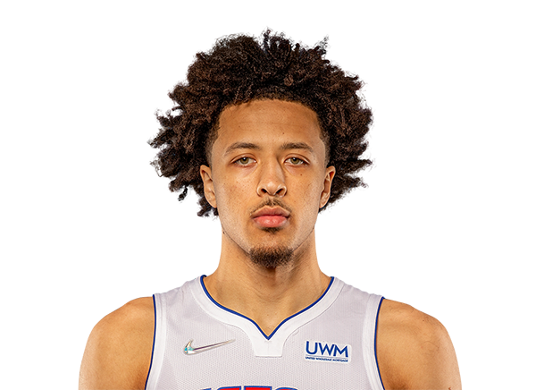
THROUGH NOVEMBER 22
 | Player | Team | GP | AST | REB | PTS | ROY Score
 | Evan Mobley | CLE | 15 | 2.5 | 8.0 | 14.6 | 285.19
 | Scottie Barnes | TOR | 16 | 3.3 | 8.4 | 14.6 | 259.83
 | Josh Giddey | OKC | 16 | 5.6 | 7.3 | 10.0 | 148.20
 | Cade Cunningham | DET | 11 | 4.6 | 6.4 | 14.1 | 125.53
 | Franz Wagner | ORL | 17 | 2.1 | 3.9 | 13.2 | 125.06
NBA STAT PADDER

Slide 8
THROUGH NOVEMBER 22
 | Player | Team | GP | AST | REB | PTS | ROY Score | Rank Change
 | Evan Mobley | CLE | 15 | 2.5 | 8.0 | 14.6 | 285.19 | ↑1
 | Scottie Barnes | TOR | 16 | 3.3 | 8.4 | 14.6 | 259.83 | ↓1
 | Josh Giddey | OKC | 16 | 5.6 | 7.3 | 10.0 | 148.20 | 0
 | Cade Cunningham | DET | 11 | 4.6 | 6.4 | 14.1 | 125.53 | ↑8
 | Franz Wagner | ORL | 17 | 2.1 | 3.9 | 13.2 | 125.06 | 0
NBA STAT PADDER

